Slide 1
Lecture 16 More GUI programming
D&D 12

Slide 2
Goals
By the end of this lesson, you should:
Be able to write Java applications with JTextField, JList, JCheckBox and JRadioButton components
Be able to implement a ButtonGroup
Be able to query the status of such checkboxes and radio buttons

Slide 3
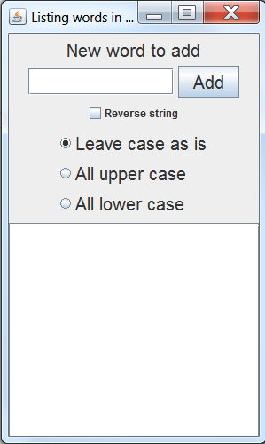
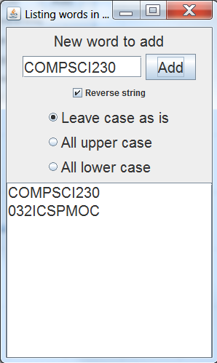
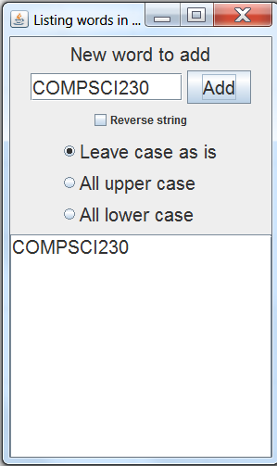
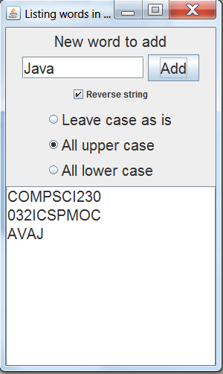
The application
The application
Startup
Imports
Overview
Constructor
Event handling
Summary

Slide 4
The application
The application
Startup
Imports
Overview
Constructor
Event handling
Summary
JFrame subclass: ListOWords
JLabel
JButton
JTextField
JCheckBox
ButtonGroup
JRadioButton
JList
JScrollPane

Slide 5
Application startup
The application
Startup
Imports
Overview
Constructor
Event handling
Summary
import javax.swing.SwingUtilities;
public class RunListOWords implements Runnable {
public void run() {
ListOWords l = new ListOWords();
}
public static void main(String[] args) {
SwingUtilities.invokeLater(new RunListOWords());
}
}
This is again the proper way of starting our Swing application to ensure it runs in the event dispatch thread.

Slide 6
Imports in ListOWords
The application
Startup
Imports
Overview
Constructor
Event handling
Summary
import java.awt.FlowLayout; // Controls general layout on JFrame
import java.awt.event.ActionListener;
import java.awt.event.ActionEvent;
import java.awt.Font; // A Font (for those at the back)
import javax.swing.JFrame;
import javax.swing.JLabel;
import javax.swing.JTextField;
import javax.swing.ListSelectionModel; // for your homework
import javax.swing.JButton;
import javax.swing.JList;
import javax.swing.ListModel;
import javax.swing.DefaultListModel;
import javax.swing.JScrollPane; // A scrollable pane for lists etc.
import javax.swing.JCheckBox;
import javax.swing.JPanel; // A panel for our radio buttons
import java.awt.GridBagLayout; // Layout for our radio buttons
import java.awt.GridBagConstraints;
import javax.swing.JRadioButton;
import javax.swing.ButtonGroup; // groups radio buttons
We need all of these imports in ListOWords.java so the Java compiler can resolve the various JComponents and AWT classes.

Slide 7
The fields in ListOWords
The application
Startup
Imports
Overview
Constructor
Event handling
Summary
public class ListOWords extends JFrame implements ActionListener {
private final JLabel label;
private final JButton button;
private final JTextField textField;
private final JList<String> wordList;
private final JCheckBox checkBoxReverseString;
private final JPanel radioButtonPanel;
private final ButtonGroup radioButtons;
private final JRadioButton radioButtonNormalCase;
private final JRadioButton radioButtonUpperCase;
private final JRadioButton radioButtonLowerCase;
…
The fields all correspond to the components we’ve identified on slide 4.
The rest of the class consists of two methods:
The constructor ListOWords(). It configures the JFrame and the components, and adds the components to the frame.
The actionPerformed() method implements the ActionListener interface. Here, it handles the ActionEvent that the Add button dispatches.

Slide 8
The constructor
The application
Startup
Imports
Overview
Constructor
Event handling
Summary
The constructor ListOWords() sets up more or less the whole GUI.
This is very common in GUI applications.
The example here shows that this can result in quite a large piece of code with little structure, even for a small application like this.
On the following slides, we will go through the constructor in “thematic” steps.

Slide 9
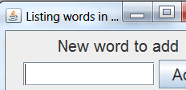
ListOWords() (part 1)
The application
Startup
Imports
Overview
Constructor
Event handling
Summary
public ListOWords() {
super("Listing words in all sorts of ways");
setLayout(new FlowLayout());
setSize(300,500);
setDefaultCloseOperation(JFrame.EXIT_ON_CLOSE);
Font font = new Font("Sans-serif", Font.PLAIN, 20);
label = new JLabel("New word to add");
label.setFont(font);
add(label);
textField = new JTextField(10);
textField.setFont(font);
add(textField);
…
Note: Configuration of the JFrame (layout, size, close behaviour) doesn’t have to happen in the class that starts the frame: Here, we have the ListOWords frame configure itself!
FlowLayout arranges the components in the order in which they are added.
The Font object here sets a font larger than default (so those of you in the cheap seats at the back can see it)
We use that font in the JLabel and JTextField, among others.

Slide 10


ListOWords() (part 2)
The application
Startup
Imports
Overview
Constructor
Event handling
Summary
button = new JButton("Add");
button.addActionListener(this);
button.setFont(font);
add(button);
checkBoxReverseString = new JCheckBox("Reverse string");
add(checkBoxReverseString);
…
The JButton configuration is the same as in our “Hello World” application.
Again, we implement the ActionListener interface in the class so just pass this.
The JCheckBox takes its label from the constructor parameter
Note: The checkbox doesn’t use the Font object (sorry if you are in the cheap seats at the back). This is to give you an idea as to what default font size is, in comparison.

Slide 11
ListOWords() (part 3)
The application
Startup
Imports
Overview
Constructor
Event handling
Summary
radioButtonPanel = new JPanel();
radioButtonPanel.setLayout(new GridBagLayout());
GridBagConstraints c = new GridBagConstraints();
c.gridx = 0;
c.gridy = GridBagConstraints.RELATIVE;
c.anchor = GridBagConstraints.WEST;
radioButtons = new ButtonGroup();
…
These lines get us ready for the radio buttons
A JPanel with a constrained GridBagLayout lets us arrange the buttons in a neat column.
Each button will be positioned with 0 offset within the panel, left-aligned (WEST), with each button positioned vertically RELATIVE to the parent component (the JPanel) or its predecessor button.
We also use a ButtonGroup. This data structure from AWT will ensure that only one of the buttons in the ButtonGroup can be checked at any one time.
Next: The radio buttons

Slide 12
ListOWords() (part 4)
The application
Startup
Imports
Overview
Constructor
Event handling
Summary
radioButtonPanel = new JPanel();
radioButtonPanel.setLayout(new GridBagLayout());
GridBagConstraints c = new GridBagConstraints();
c.gridx = 0;
c.gridy = GridBagConstraints.RELATIVE;
c.anchor = GridBagConstraints.WEST;
radioButtons = new ButtonGroup();
…
These lines get us ready for the radio buttons
A JPanel with a constrained GridBagLayout lets us arrange the buttons in a neat column.
Each button will be positioned with 0 offset within the panel, left-aligned (WEST), with each button positioned vertically RELATIVE to the parent component (the JPanel) or its predecessor button.
We also use a ButtonGroup. This data structure from AWT will ensure that only one of the buttons in the ButtonGroup can be checked at any one time.
Next: The radio buttons

Slide 13
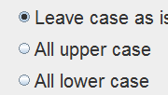
ListOWords() (part 5)
The application
Startup
Imports
Overview
Constructor
Event handling
Summary
radioButtonNormalCase = new JRadioButton("Leave case as is");
radioButtonNormalCase.setFont(font);
radioButtonNormalCase.setSelected(true);
radioButtons.add(radioButtonNormalCase);
radioButtonPanel.add(radioButtonNormalCase, c);
radioButtonUpperCase = new JRadioButton("All upper case");
radioButtonUpperCase.setFont(font);
radioButtons.add(radioButtonUpperCase);
radioButtonPanel.add(radioButtonUpperCase, c);
radioButtonLowerCase = new JRadioButton("All lower case");
radioButtonLowerCase.setFont(font);
radioButtons.add(radioButtonLowerCase);
radioButtonPanel.add(radioButtonLowerCase, c);
add(radioButtonPanel);
…
Note we set the first of the buttons as being selected.
We then add the buttons both to the ButtonGroup and to the JPanel.
Finally, we add the panel to the JFrame

Slide 14
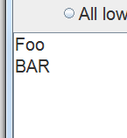
ListOWords() (part 6)
The application
Startup
Imports
Overview
Constructor
Event handling
Summary
wordList = new JList<String>(new DefaultListModel<String>());
wordList.setFont(font);
wordList.setVisibleRowCount(25);
wordList.setFixedCellHeight(25);
wordList.setFixedCellWidth(280);
add(new JScrollPane(wordList));
setVisible(true);
The DefaultListModel tells the JList how to implement the list internally, in this case as a Vector (a data structure similar to an ArrayList)
The visible row count gives us the number of elements on the list that are visible without scrolling
Packaging the list in a JScrollPane lets us scroll
Cell height/width are the height and width of each individual element cell
Play with these values to see what happens!

Slide 15
actionPerformed()
The application
Startup
Imports
Overview
Constructor
Event handling
Summary
public void actionPerformed(ActionEvent event) {
String newWord = textField.getText();
if (checkBoxReverseString.isSelected()) {
String reverseWord = "";
for (int i = newWord.length() - 1; i >= 0; i--) {
reverseWord += newWord.charAt(i);
}
newWord = reverseWord;
}
if (radioButtonUpperCase.isSelected()) {
newWord = newWord.toUpperCase();
}
if (radioButtonLowerCase.isSelected()) {
newWord = newWord.toLowerCase();
}
((DefaultListModel)(wordList.getModel())).addElement(newWord);
}
We check whether the checkbox is checked and reverse the string from the text field if required.
We then check which radio button is checked and compute the upper/lowercase version as applicable.
We then add the new word to the list…

Slide 16
actionPerformed()
The application
Startup
Imports
Overview
Constructor
Event handling
Summary
((DefaultListModel)(wordList.getModel())).addElement(newWord);
This looks a bit complex, right? Our problem here is that there is no uniform way to add elements to a JList. The methods for adding to a JList are defined in its list model.
The list model is an interface, which is not implemented by the JList class, but by the underlying data structure that implements the list (in our case, the vector). So what we need to do here is:
Get a reference to the underlying data structure with wordList.getModel(). This returns an object that implements a ListModel interface. Unfortunately, addElement() is not a method of ListModel.
However, we know that the object returned is actually an instance of the DefaultListModel class, which has an addElement() method. So we typecast the ListModel return value to a DefaultListModel, and call addElement() on this reference.

Slide 17
What do we know
The application
Startup
Imports
Overview
Constructor
Event handling
Summary
We can configure the size and behavior of a JFrame subclass in its constructor.
Using a Font object with setFont() allows us to change the font type and size on components.
We can read the text in a JTextField with its getText() method.
Radio buttons are typically grouped so only one of the buttons in the group can be checked.
Checkboxes and radio buttons’ check states can be queried with the isSelected() method.
The underlying storage in a JList is controlled by a data model.
If we want a JList to scroll, we can package it in a JScrollPane
Sometimes, we need type casting!

Slide 18
Resources & Homework
The application
Startup
Imports
Overview
Constructor
Event handling
Summary
D&D Chapter 12
https://docs.oracle.com/javase/tutorial/uiswing/components/textfield.html
https://docs.oracle.com/javase/tutorial/uiswing/components/button.html
https://docs.oracle.com/javase/tutorial/uiswing/components/list.html
https://docs.oracle.com/javase/tutorial/uiswing/layout/gridbag.html
Homework:
Refactor (rewrite) the constructor of the ListOWords class such that it uses a series of private methods to set up the different parts of the GUI.

Slide 19
Next Lecture
Even more GUI programming (Chapter 12)

